Slide 1

Elastic Search with .net

Slide 2
Main usages of elastic search
Logging & Log Analysis
Combing Public Data
Metrics
Full-Text Search
Data Visualization (with Kibana)

Slide 3
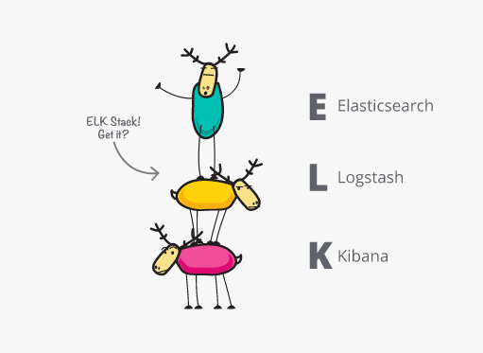
Logging and log analytics
We need more than Elasticsearch
We need the ELK stack + Serilog
Elasticsearch – indexes the logs
Logstash – aggregates logs
Kibana – log visualization
Serilog – .NET logger
You install the above with Docker or manually
And configure the IPs but for demo purposes, we are going to use local host
You may want to configure Logstash filters:
https://www.elastic.co/blog/logstash_lesson_elasticsearch_mapping

Slide 4
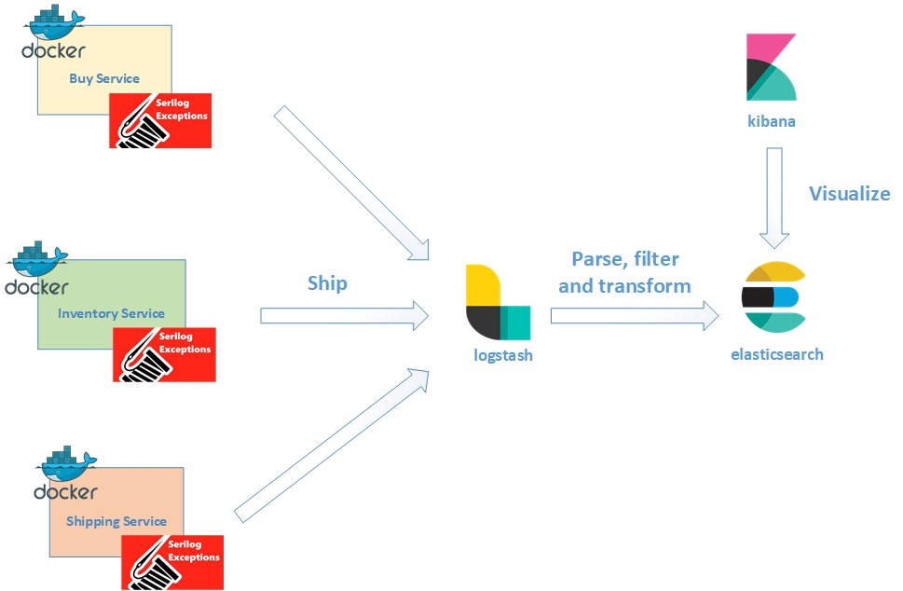
Logging and log analytics

Slide 5
Logstash configuration
input {
http {
host => "localhost"
port => 28080
codec => json
}
}
output {
elasticsearch {
hosts => "localhost:9200"
index => "carrental-logs"
document_type => "log"
}
stdout { }
}

Slide 6
Logstash Filters Example
filter {
split {
field => "events"
target => "e"
}
mutate {
remove_field => ["events", "headers"]
}
}

Slide 7
Serilog packages
Serilog.AspNetCore
Serilog.Settings.Configuration
Serilog.Sinks.Async
Serilog.Sinks.Http
Serilog.Sinks.File

Slide 8
Serilog Configuration
public static class CarRentalHost
{
public static void Start<TStartup>(string[] args = null) where TStartup : class
{
args ??= Array.Empty<string>();
// Preferably use Environment.GetEnvironmentVariable("MY_VARIABLE");
Log.Logger = new LoggerConfiguration()
.Enrich.FromLogContext()
.WriteTo.Http("http://host.docker.internal:28080")
.CreateLogger();
// Continues to the next slide…

Slide 9
Serilog Configuration
// …continues from the previous slide
Host
.CreateDefaultBuilder(args)
.UseSerilog()
.ConfigureWebHostDefaults(webBuilder => webBuilder
.UseStartup<TStartup>())
.Build()
.Run();
}
}
// You can add UseSerilogRequestLogging in the application builder

Slide 10
Configure kibana
Create index pattern to visualize data
Fill the index name and the timestamp
Go to discover and validate the logs
Kibana is a very powerful tool
And it is worth a lesson on its own

Slide 11
Logging best practices
Do not overlog in your code
Add action filters to reduce the "ugliness"
Don’t let logging block your application
Store logs outside your data center
Set up common searches, dashboards, and alerts for your team
Use correlation ID in microservices environment
More available here:
https://www.loggly.com/blog/30-best-practices-logging-scale/

Slide 12
Full-text search
Install NEST and configure it in the global services:
var connectionString = configuration.GetValue<string>("ElasticSearchConnection");
var indexName = typeof(TModel).Name.ToLower();
var node = new Uri(connectionString);
var settings = new ConnectionSettings(node)
.DefaultMappingFor<TModel>(s => s.IndexName(indexName));
var client = new ElasticClient(settings);
client.Indices.Create(
indexName,
index => index
.Map<TModel>(p => p.AutoMap()));
services.AddSingleton<IElasticClient>(client);

Slide 13
Full-text search
Create a full text search service and use it:
public Task Index<TDocument>(TDocument value) where TDocument : class
=> this.elasticClient.IndexDocumentAsync(value);
public async Task<IEnumerable<TDocument>> Query<TDocument>(Expression<Func<TDocument, object>> field,
string query) where TDocument : class
{
var result = await this.elasticClient
.SearchAsync<TDocument>(s => s
.Query(q => q
.MatchPhrase(m => m.Field(field)
.Query(query))));
return result.Documents;
}

Slide 14
ANY QUESTIONS?

